Slide 3
Grateful
and
Generous

Slide 4
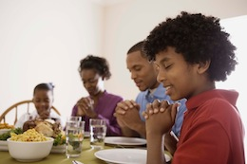
Grateful
Grateful

Slide 5
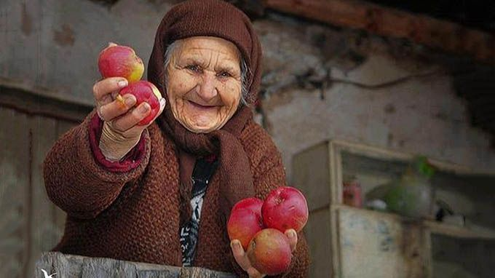
Generous
Generous

Slide 6
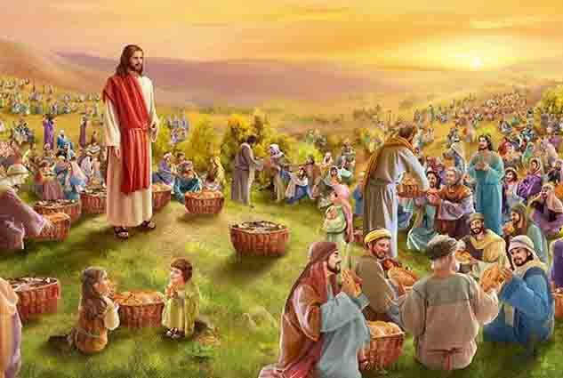

Slide 8
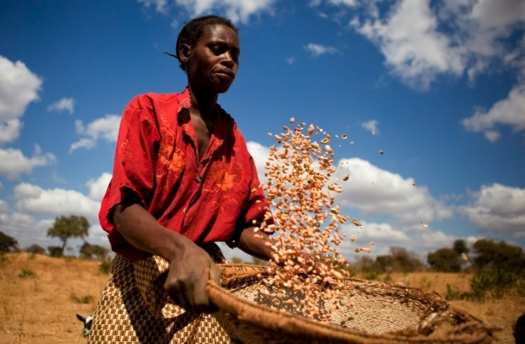
Feeding of the 5,000 assembly
Notes:
This PowerPoint accompanies the ‘Feeding of the 5,000’ primary assembly.

Slide 9
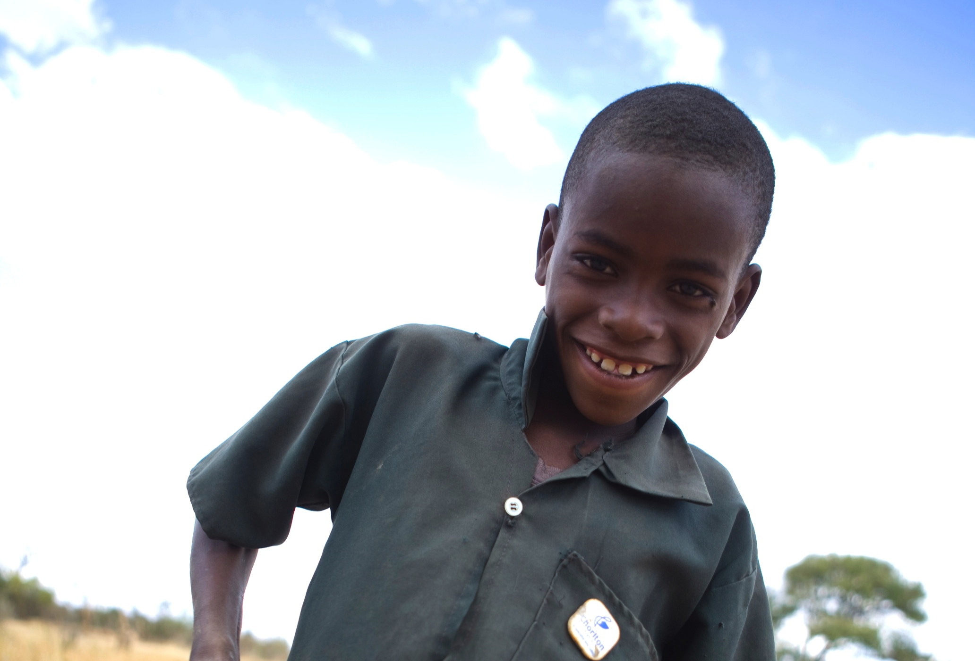
Notes:
The following 4 slides accompany Gift’s story’ ‘section of the assembly.
Gift is a nine year old boy from Zambia – his parents gave him this name because they weren’t expecting to have children. When he was born they believed he was a gift from God!
Gift’s life used to be quite hard. His family were poor and his mum had been quite ill. They didn’t have jobs and they had very little money. For a time, they could only afford to eat pumpkin leaves.
But soon Gift’s life began to improve. The first gift for Gift was…

Slide 10
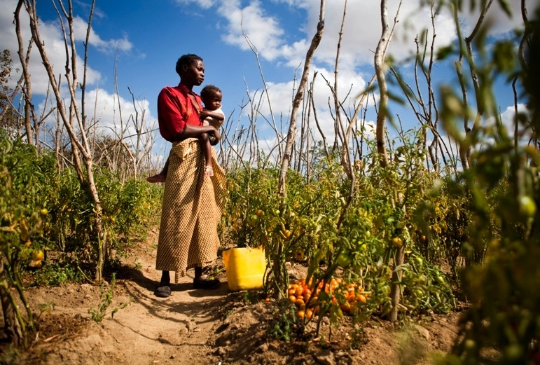
Notes:
This trowel represents the tools and seeds that are making a huge difference to the lives of Gift’s family. They are learning how to grow and look after vegetables and CAFOD has provided a clean water system to help them. It means that Gift’s family can grow things like this…

Slide 11
Notes:
…tomato! Being able to grow their own food means that Gift’s family have more nutritious food to eat, and they’re all becoming much more healthy. There’s plenty to go round and the family can even make money by selling their vegetables at the market. Which means they can buy things like this…

Slide 12
Notes:
…book! When they were very poor, it was hard for Gift to get to school. His family couldn’t afford to send him. Now, Gift is able to go to school – he loves maths and can be found working out sums in the sand outside his home.
All of these things are really helping to transform the lives of Gift and his family. Gift says:
“I go to the vegetable garden once a day to stop birds and animals from eating the tomatoes. I also help my mum to water the crops. I like the garden, because when I see the tomatoes grow, I know my mum will be happy. We have a little bit more money now and that’s good because we can eat more food.”

Slide 14
Help us to share
Notes:
This slide accompanies the ‘Prayers of Intercession’ section of the assembly.
Thank you, Lord, for the foods we enjoy. Teach us how to share what we have.
Help us to share.
Thank you, Lord, for showing us how to share. May we follow your example.
Help us to share.
Thank you, Lord, for sharing your love with everyone. Help us to do the same.
Help us to share.
Thank you, Lord, for the wonder of creation, for the sun, the rain and the earth. We pray that we may share your gifts.
Help us to share.
Thank you, Lord, for Gift and his family. We pray that they will be blessed.
Help us to share.
Thank you, Lord, for our school family. Remind us to work together.
Help us to share.

Slide 15
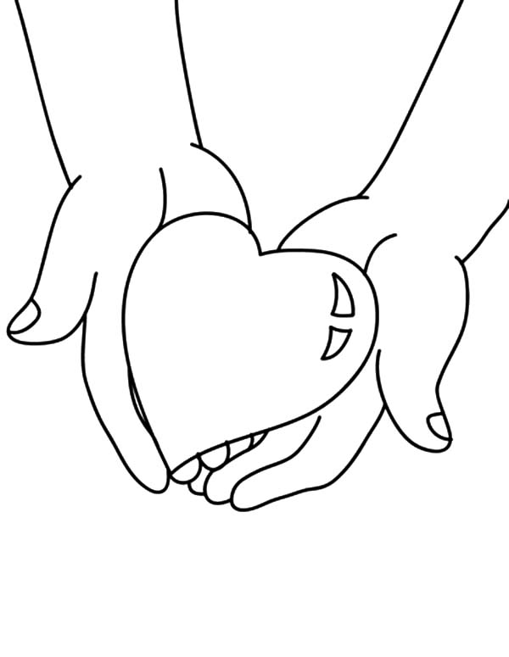

Slide 16
Generous God,
We thank you for all of your gifts.
Help us to think of the needs of others.
You show us how to love and share with everyone.
We pray that we may truly share what we have,
and so help our sisters and brothers
throughout the world.
Amen.
Notes:
This slide accompanies the ‘Closing Prayer’ section of the assembly.

Slide 17
Photography: Simon Rawles
Illustration: Per José Karlen

